Slide 1


Mid-Term Project Video Rental Shop
Group 10
Amit Pandit
Kishankumar Zalavadiya
Lalith Kumar S
Nithin Huliyappa

Slide 2
Agenda
Overview of the database
Entities and relationships
Addressing 8 conditions
Highlights of design
Challenges

Slide 3

Overview of the database
The database is about a video rental shop where different actors such as owner , employees, vendors and customers are involved.
Along with that database takes care of storing information about the inventory, orders placed to vendors,invoices generated and rentals given to customers.

Slide 4

Entities
Employee
Customer
Vendor
MovieInventory
MovieType
Rental
Supplied
Orders
EmployeeTypeSalary
Schedules
Worklog

Slide 5
Relationships

Slide 6

How we are addressing 8 conditions ?

Slide 7
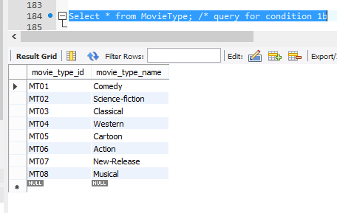
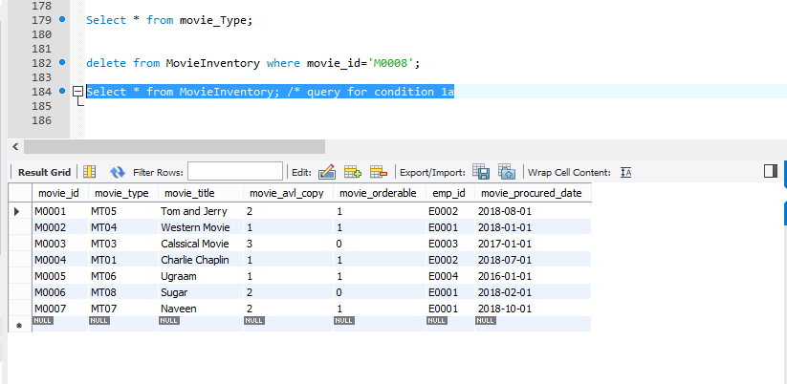
Condition 1
The movie type classification is standard; not all types are necessarily in stock.
Table : MovieType
This table has standard classification of all movie types.
Table :MovieInventory
This table is for stock where not all movie types are present.
For example :
“Science-fiction” type can be seen in MovieType but not in MovieInventory

Slide 8
Condition 2
The movie list is updated as necessary; however, a movie on that list might not be ordered if the video shop owner decides that the movie is not desirable for some reason.
Table : MovieInventory
The attribute “movie_orderable” takes care of the above condition. If the entry is 0 (False) then it can’t be ordered else 1 (True) it can be ordered

Slide 9
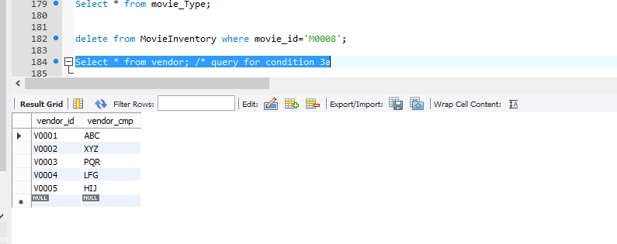
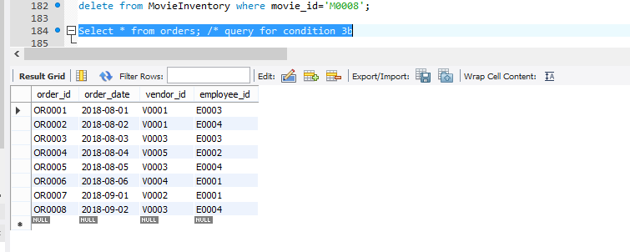
Condition 3
The video rental shop does not necessarily order movies from all vendors on the vendor list; some vendors on the vendor list are merely potential vendors from whom movies may be ordered in the future.
Table : Vendor
This table keeps track of all vendors for the shop
Table : Orders
This table keeps track of all orders raised for different vendors

Slide 10
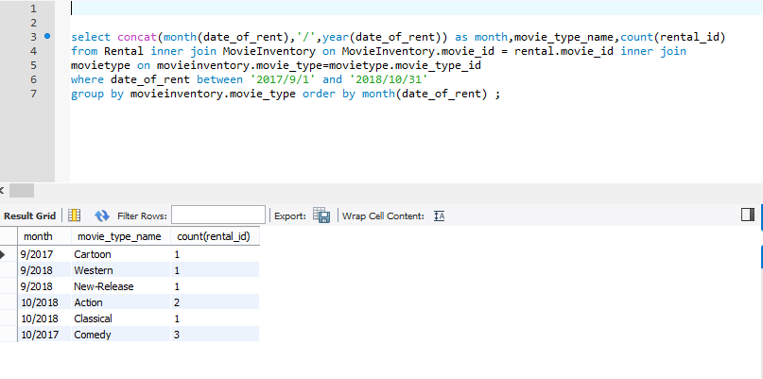
Condition 4
Movies classified as new releases are reclassified to an appropriate type after they have been in stock for more than 30 days. The video shop manager wants to have an end-of-period (week, month, year) report for the number of rentals by type.
Monthly

Slide 11
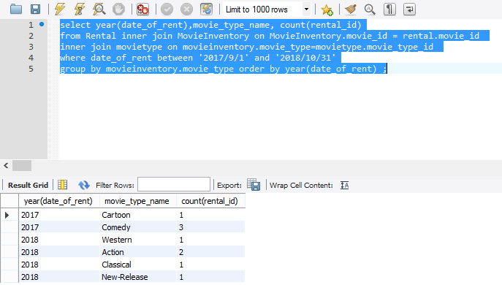
Condition 4
Movies classified as new releases are reclassified to an appropriate type after they have been in stock for more than 30 days. The video shop manager wants to have an end-of-period (week, month, year) report for the number of rentals by type.
Yearly

Slide 12
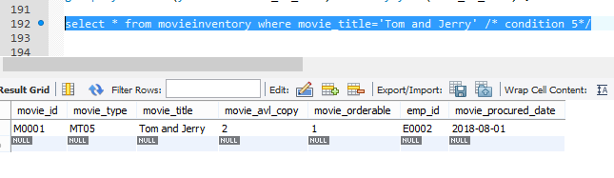
Condition 5
If a customer requests a title, the clerk must be able to find it quickly. When a customer selects one or more titles, an invoice is written. Each invoice can contain charges for one or more titles. All customers pay in cash.
Table : MovieInventory
Clerk just perform select query on MovieInventory in order to find the customer requested title.

Slide 13
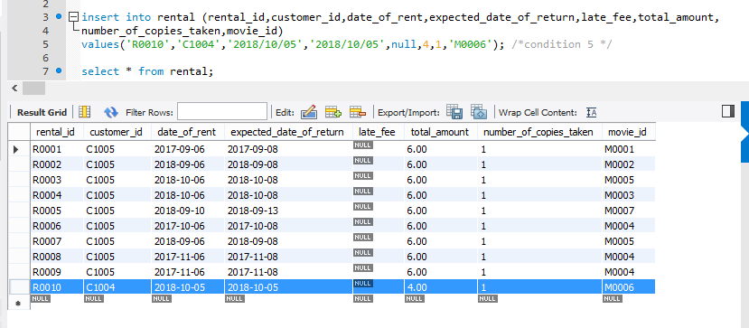
Condition 5
If a customer requests a title, the clerk must be able to find it quickly. When a customer selects one or more titles, an invoice is written. Each invoice can contain charges for one or more titles. All customers pay in cash.
Table : MovieInventory
After checkout clerk will update the Rentals table with invoice details.

Slide 14
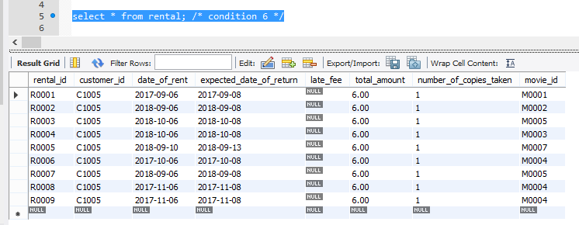
Condition 6
When a customer checks out a title, a record is kept of the check-out date and time and the expected return date and time. When rented titles are returned, the clerk must be able to check quickly whether the return is late and to assess the appropriate late return fee.
Table : Rental
A simple select query on Rental will fetch the required details.

Slide 15
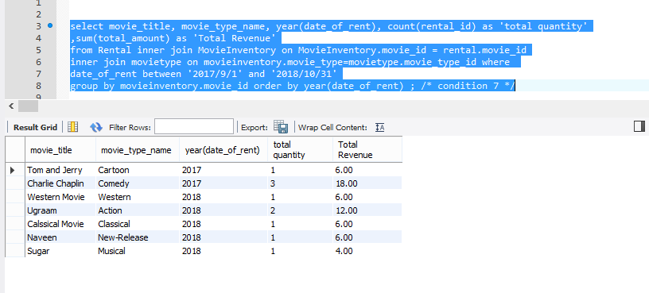
Condition 7
The video store owner wants to generate periodic revenue reports by title and by type. The owner also wants to generate periodic inventory reports and track titles on order.

Slide 16
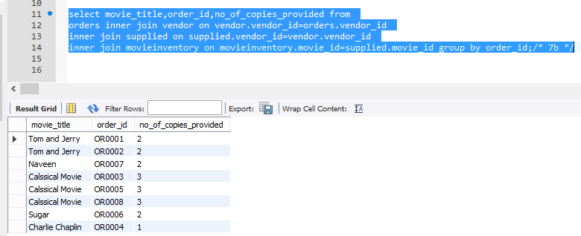
Condition 7
The video store owner wants to generate periodic revenue reports by title and by type. The owner also wants to generate periodic inventory reports and track titles on order.

Slide 17
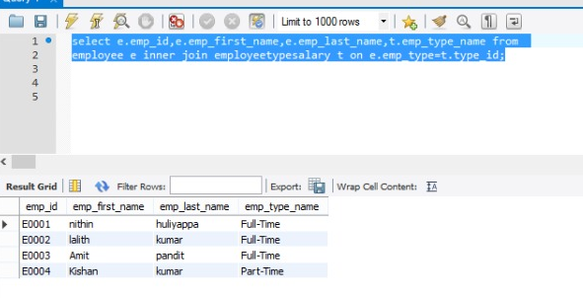
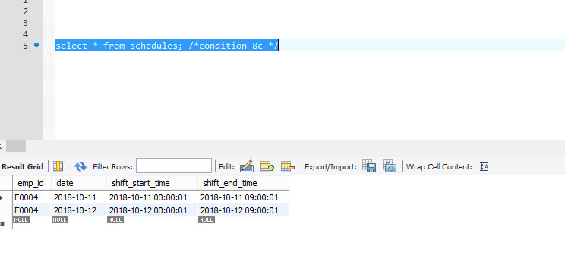
Condition 8
The video store owner, who employs two (salaried) full-time and three (hourly) part-time employees, wants to keep track of all employee work time and payroll data. Part-time employees must arrange entries in a work schedule, while all employees sign in and out on a work log.
Table : Employee
This table keeps track of all employees
Table : schedules
This table is for part-time employees to arrange their work schedules having sign in out.

Slide 18
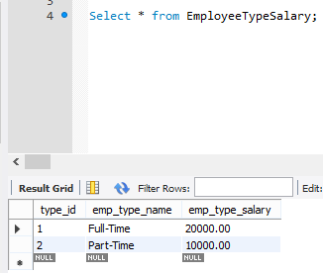
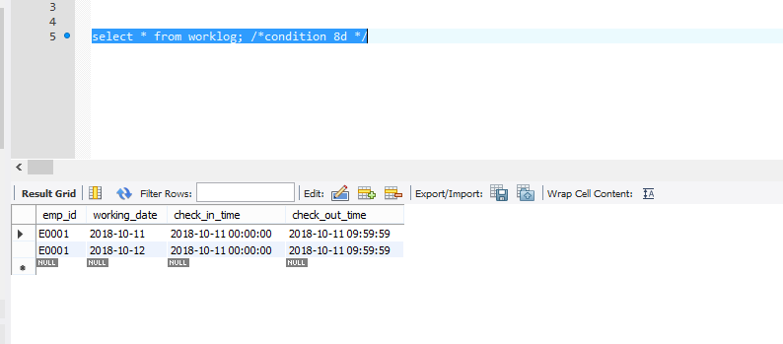
Condition 8
The video store owner, who employs two (salaried) full-time and three (hourly) part-time employees, wants to keep track of all employee work time and payroll data. Part-time employees must arrange entries in a work schedule, while all employees sign in and out on a work log.
Table : EmployeeTypeSalary
This table keeps track of payroll data for all employees
Table : worklog
This table keeps track of work logs for all employees (not only part time)

Slide 19

Challenges
Identifying the relationships and satisfying the conditions accordingly.
Optimizing the ERD so that we can generate the reports with simple SQL Queries.

Slide 20
Highlights of design
Instead of keeping the invoice table separately we will be dealing with the rental entity solely.
In order to break the N-N relation between MovieInventory and Orders we have created a special table Supplied.

Slide 21

Questions

